Slide 1


College Event Feedback System
Empowering Student Voice through Event Insights
by anurag verma

Slide 2
Project Overview
Purpose
User Roles
Technology Stack
Web application for student feedback on college events.
Separate interfaces for Students and Administrators.
Built with React, TypeScript, and TailwindCSS for modern design.

Slide 3




Key Objectives
Structured Feedback
Improve Event Quality
Enable students to provide organized input.
Support administration with data-driven insights.
Visualize Trends
Show sentiment and participation over time.

Slide 4
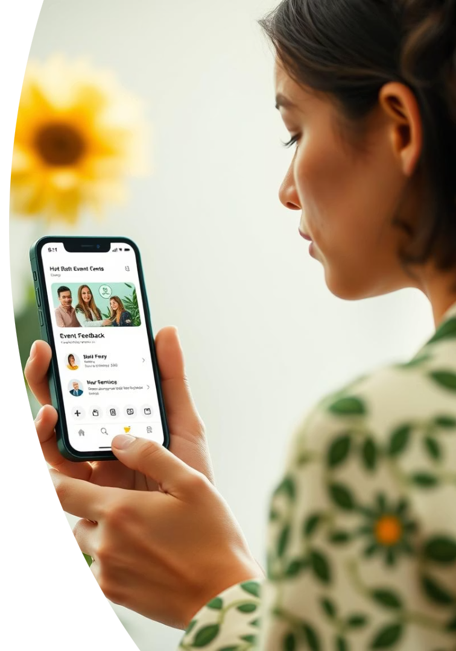
Student Features
Submit Feedback
Quickly rate and comment on events.
Upcoming Events
Browse and plan for future activities.
Feedback History
Review all past submissions.
Sentiment Insights
Understand personal feedback impact.

Slide 5




Administrator Features
Access Feedback
Sentiment Analysis
Manage Events
Oversee event data and details.
Comprehensive view of all student submissions.
Track trends and statistics on feedback.

Slide 6






Student Dashboard
Completed Events
List of events ready for feedback.
Personal Welcome
Custom greeting with student's name.
Recent Feedback
Quick view of latest sentiment tags.

Slide 7




Event Listings
Upcoming Events
Displays all future college activities.
Search & Filter
Find events by name, date, or category.
Detailed Information
Includes name, date, description, location, and image.

Slide 8




Submit Feedback
Select Event
Choose event from listed options.
Rate & Comment
Provide ratings and written feedback.
Submit
Confirm and send feedback.

Slide 9
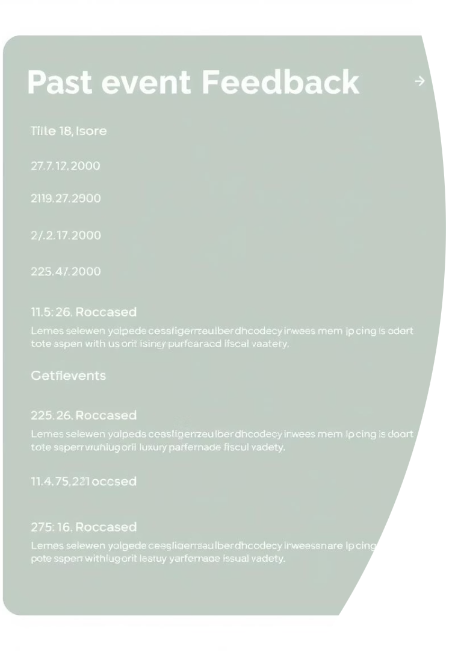
Feedback History
Chronological View
Feedback entries ordered by date.
Key Details
Ratings, comments, sentiment, and event info.
Searchable
Easily locate specific feedback entries.

Slide 10
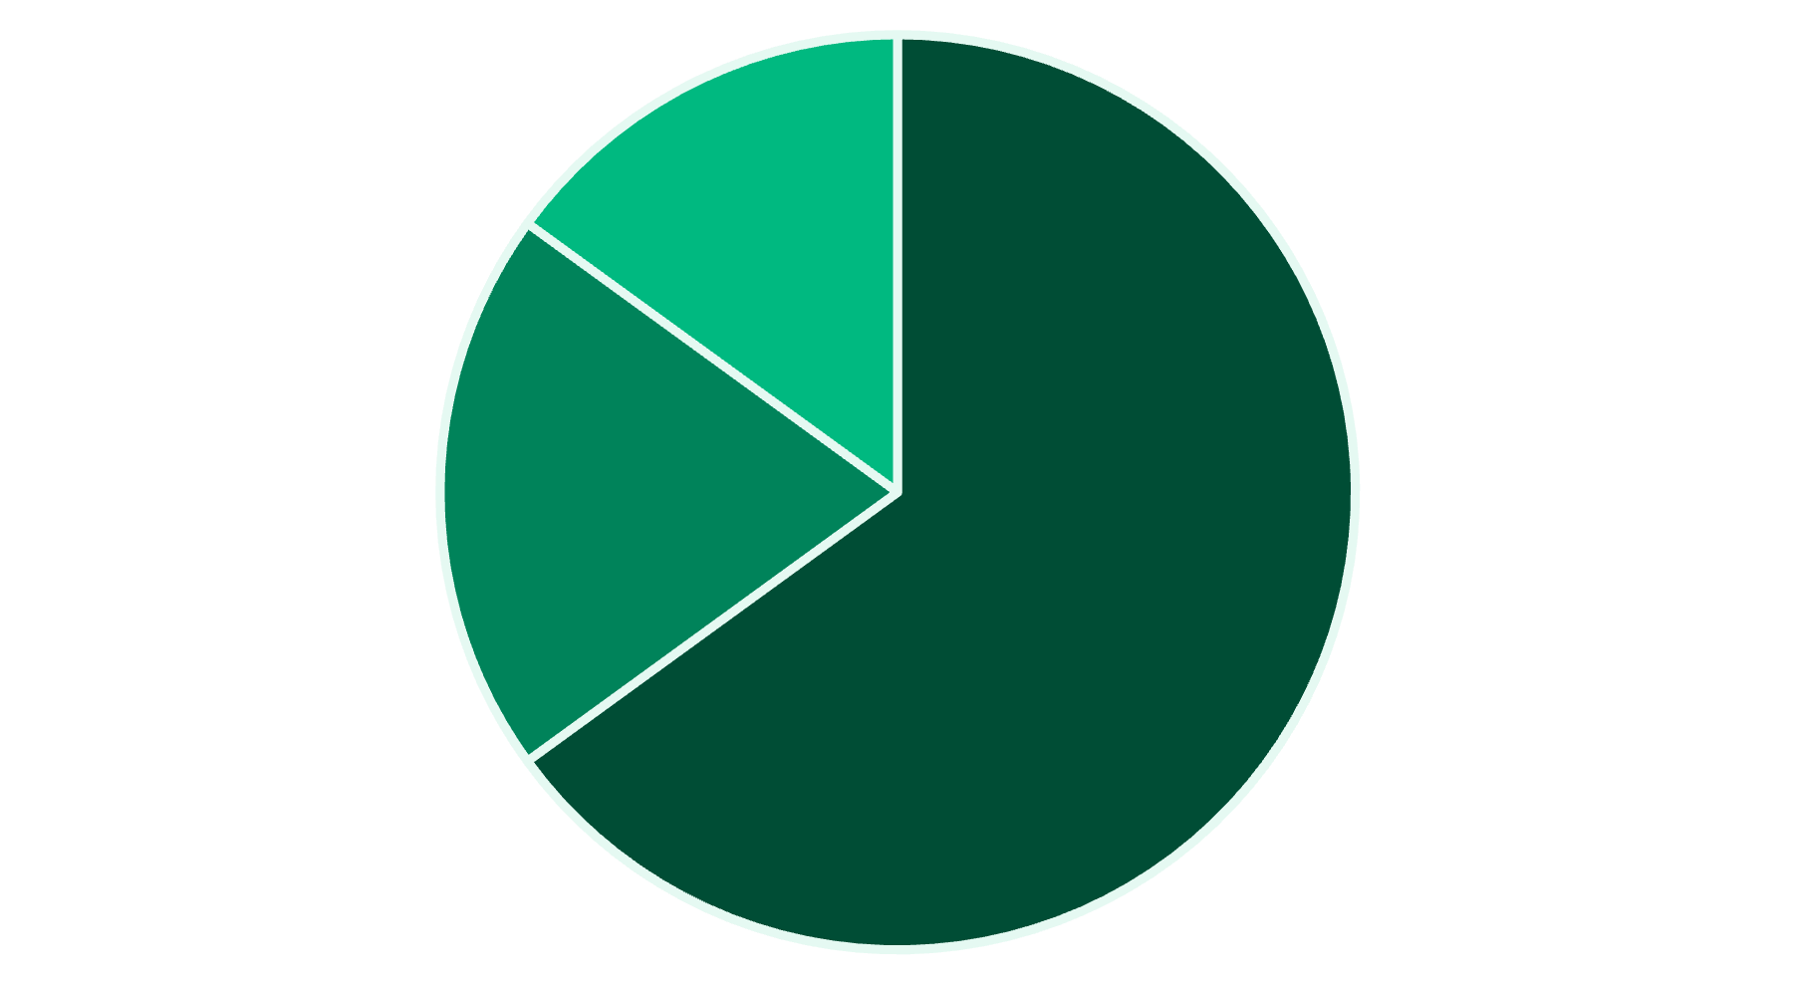
Feedback Analysis
Detailed insights for administrators.
Key stats: total feedback, average rating, participation rate.
Filters for event, date range, and sentiment.
Sentiment distribution chart for quick overview.
Positive
Negative
Sentiment trend timeline shows changes over time.
Neutral

Slide 11
Future Improvements
Backend integration with real API.
User authentication and JWT.
Admin dashboard enhancements.
Event management features.

